Slide 1

The Personal Statement Part 2
Presenters
Mukamani Luchera
Esther Nzau
ECC 2021
This Photo by Unknown author is licensed under CC BY.

Slide 2

Introduction
Essays are arguably the most important soft factors considered when making college admission decision.
And in a year where more colleges than ever are test optional, soft factors like the essay will carry even more weight in the admissions process this fall.
To improve your essays, certain things are crucial to implement and others to avoid in one's personal statement.
This Photo by Unknown author is licensed under CC BY-ND.

Slide 3
The DOs and DONTs

Slide 4
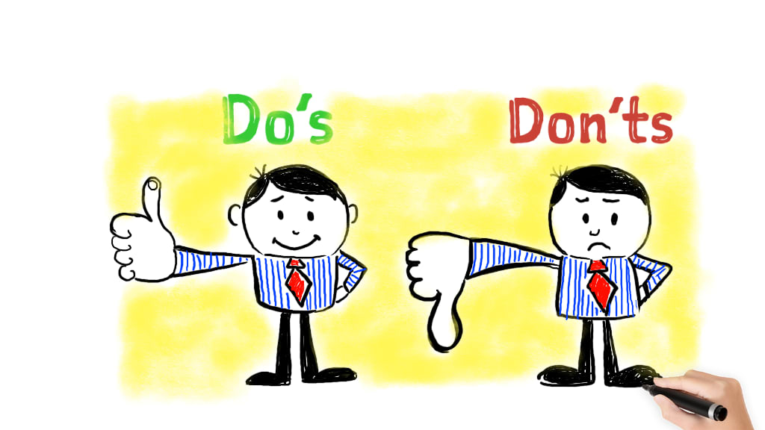
The DOs
Be vulnerable – Use more expressive adjectives and describe situations rather than naming them. A popular saying is bleeding your heart out on a paper to
Show don't tell – This ties back to the first statement about being vulnerable where you can't just tell an admissions officer "I'm curious", you should show them by describing situations that show your curiosity.
Write badly - Don't be afraid to have that first horrible draft. Every journey starts with that one step. Write that bad draft and work together with your mentor to make that draft good with time. Your first draft will never be perfect.
Share with your mentor and at most two close friends - Your mentor and friends will give you a perspective you had not thought of before and may be quick to catch any grammatical or structural errors in your essays.
Overwrite - Write as many words as you please in your first draft. You will eventually cut out parts that are unnecessary and substitute longer sentences with shorter sentences, for example, "I would love to be a ..." could be replaced by "I anticipate being a ..."
This Photo by Unknown author is licensed under CC BY-SA-NC.

Slide 5
The DONTs
A) Plagiarism
Types
Direct plagiarism (copy and paste)
Mosaic plagiarism (no quotation marks)
Self-plagiarism
Accidental plagiarism
The repercussions are as severe as getting rejected, and the school contacting other schools to also reject your application.
This Photo by Unknown author is licensed under CC BY-SA-NC.

Slide 6
B) Repetition
It shows lack of creativity
Use the correct synonyms eg prevent a situation from accelerating
C) Cliché
Starting with quotes
Research on school specific cliches to avoid
D)Deviate
Don’t give a different topic too much attention

Slide 7
E) Unexplained Abbreviations
Do not assume the admission officer know what KCSE means or any local abbreviation.
F) Unexplained Statistics
Do not assume or make up any statistics
Do not use statistics from unreliable source (wikipedia).
Do extensive research

Slide 8
G) Name dropping
Don’t shift the attention from you.
H) controversy
Avoid making a stance on sensitive topics
Avoid using any use of slur
I) Do not panic!!

Slide 9

Continuation
We will now go through the examples of successful essays not read yesterday, and more, and analyze them.

Slide 10

QUESTIONS

